Slide 1
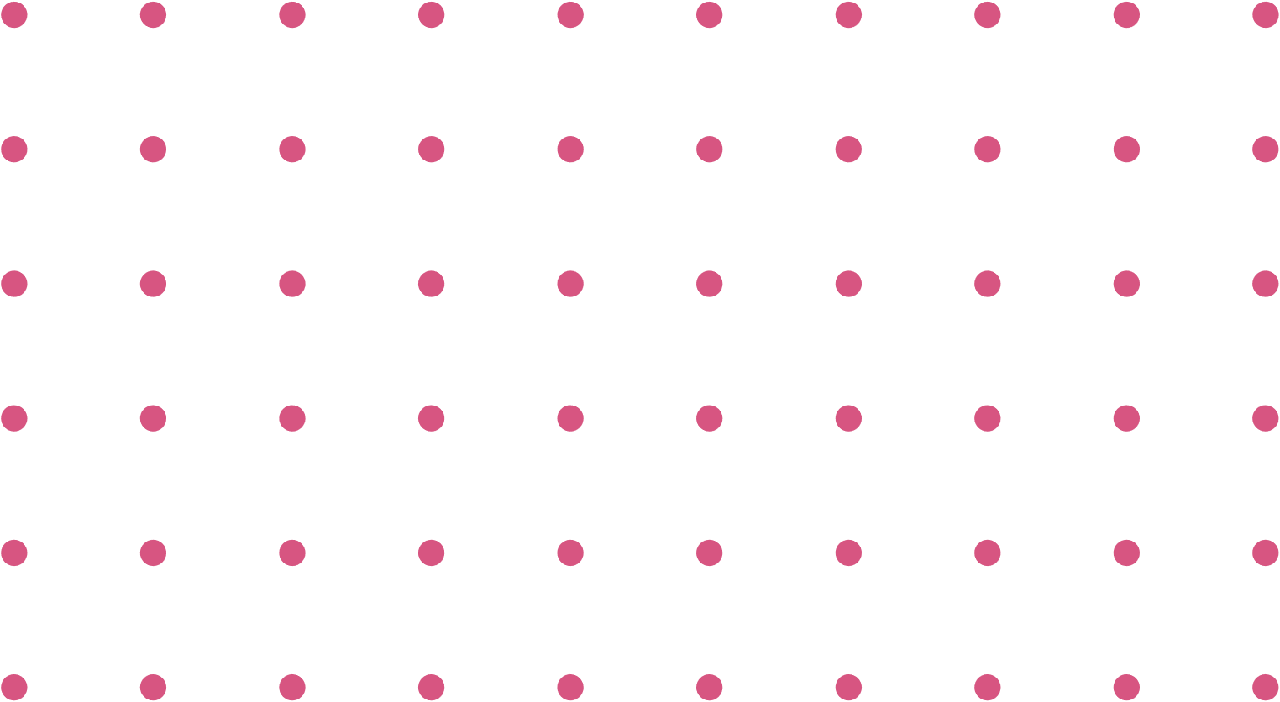


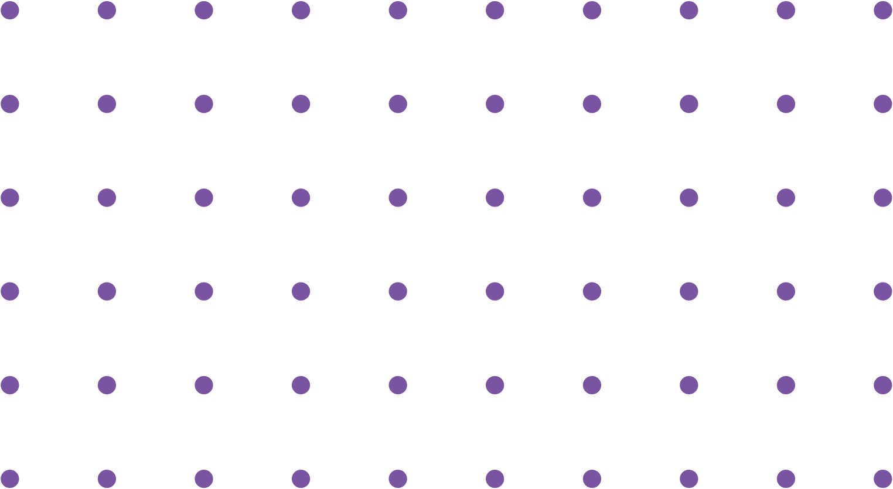
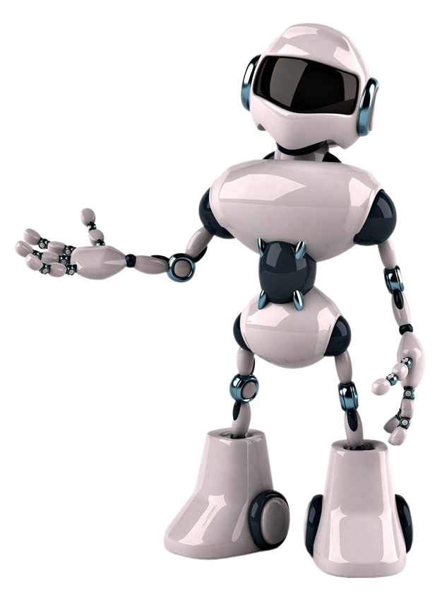





Modeling and Performance Evaluation
Session-2
Osama Alyami
Shahad Ajibi
Sadeem AlMesned
Munera Alsaeed
7:00 - 9:00 PM

Slide 2
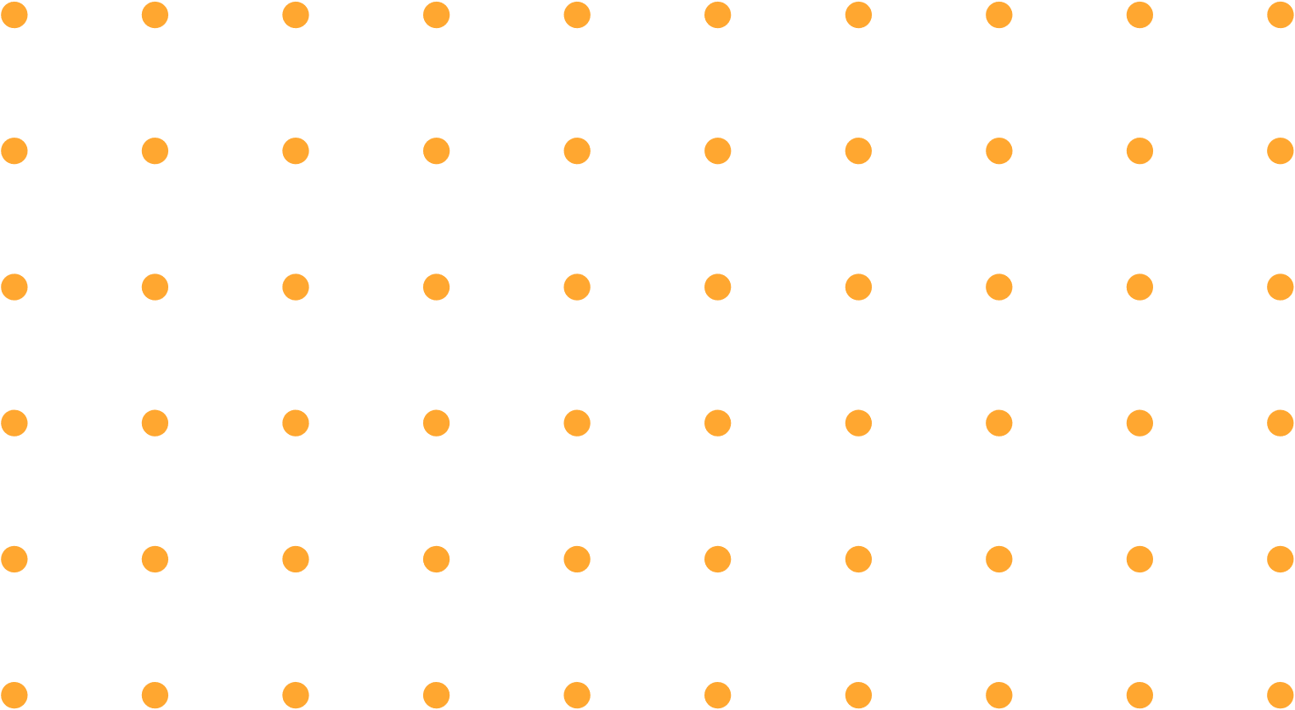


Agenda
01
ML Algorithms:
- k-Nearest Neighbor (k-NN)
- Support Vector Machine (SVM)
02
ML Model Evaluation
03
Generalization and the Problem of Bias and Variance
04
Data Splitting

Slide 3

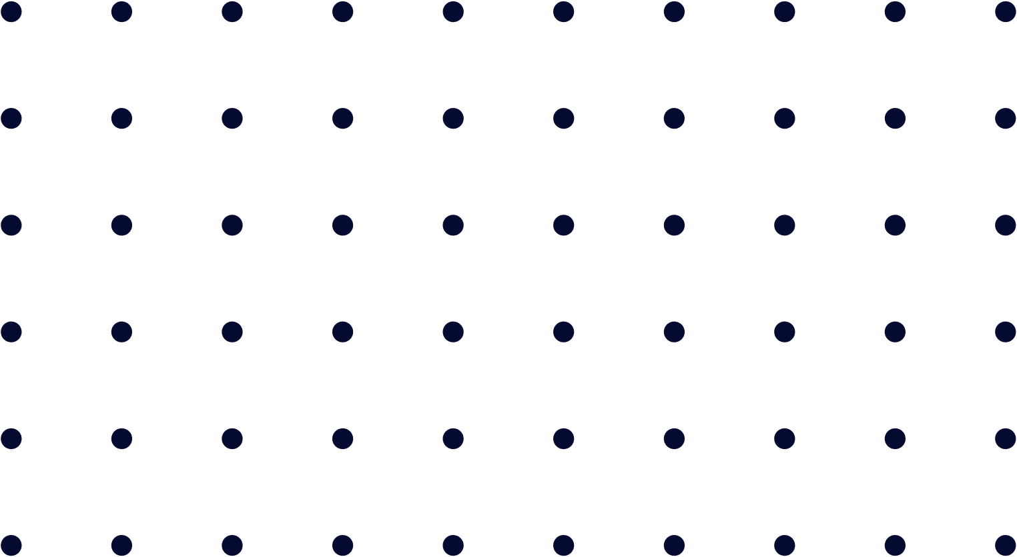




Osama Alyami
ML Algorithms
K-Nearest Neighbors (K-NN)
Support Vector Machine (SVM)

Slide 4



Osama Alyami
What is K-Nearest Neighbors ?
KNN is one of the simplest supervised machine Learning algorithm mostly used.
It classifies a data point based on how its neighbors are classified.
Odd value of K is selected to avoid confusion between two classes.
KNN stores all available cases and classifies new cases based on a similarity measure.

Slide 5
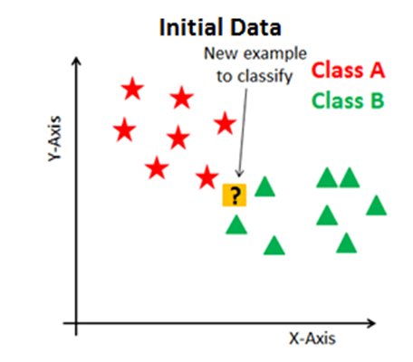
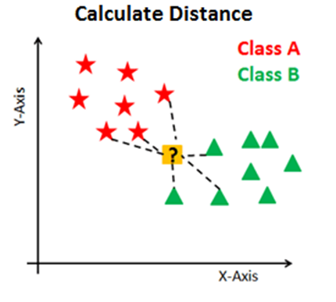
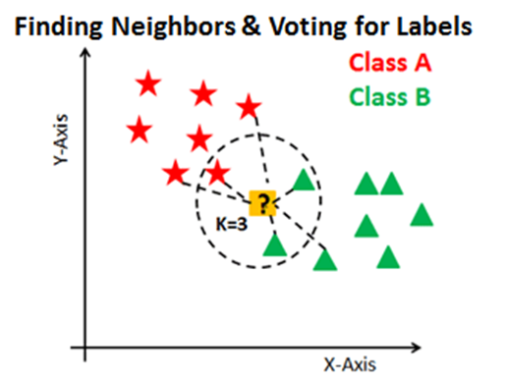
Osama Alyami
How it works ?
Steps:
Calculate distance
Find closest neighbors
Vote for labels

Slide 6
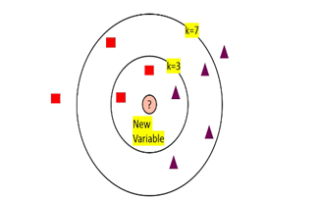
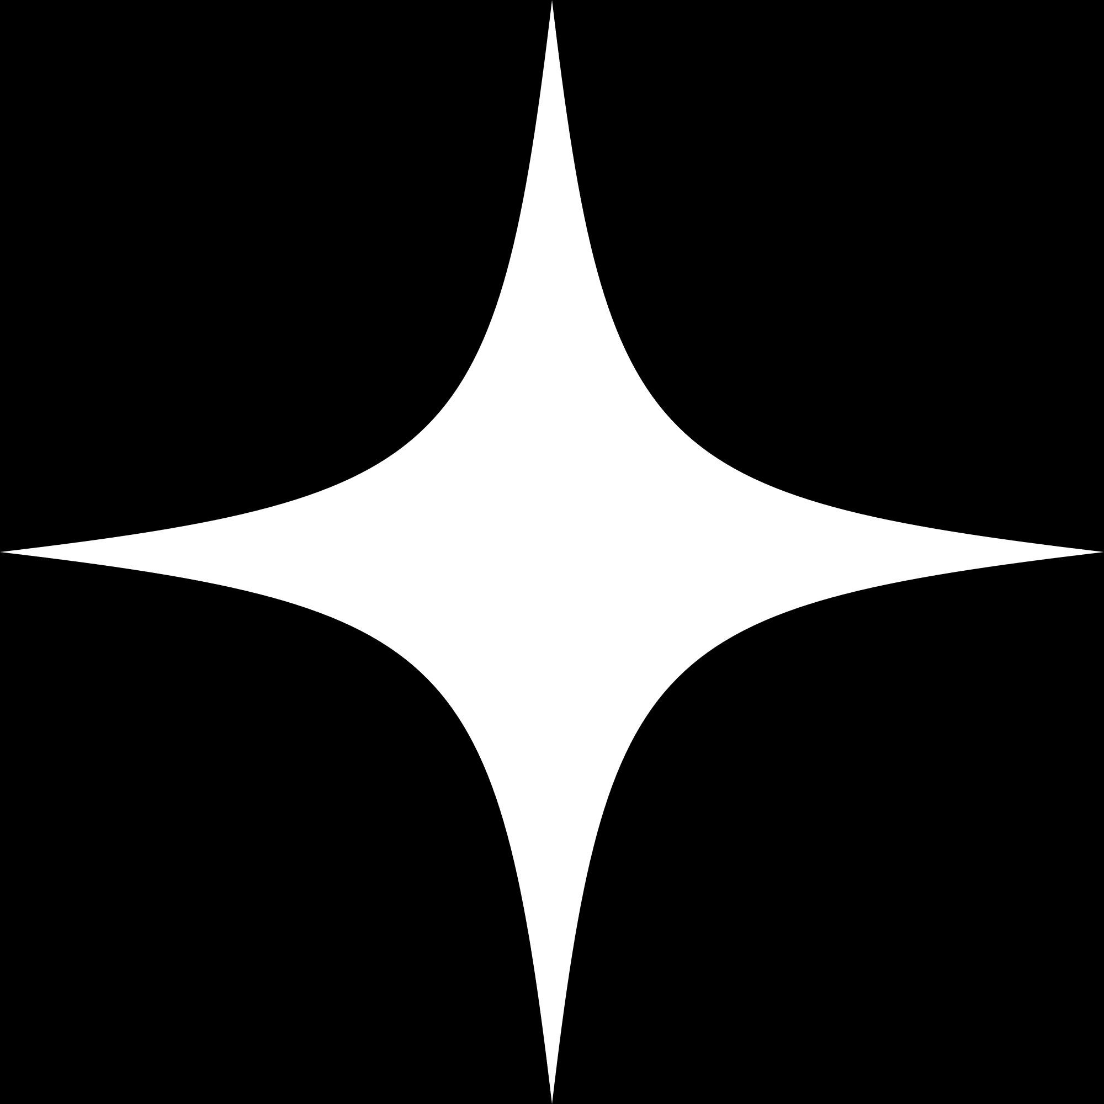
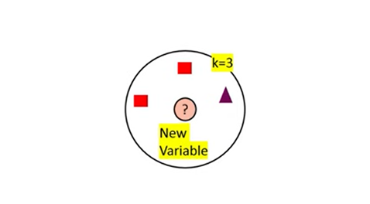
Osama Alyami
K parameter & Voting
The number of neighbors(K): is a hyperparameter that you need to choose at the time of model building. You can think of it as a controlling variable for the prediction model.
Choosing the optimal K is best done by first inspecting the data.
Historically the optimal K for most datasets has been between 3-10.
When K=7 we can classify ‘?’ .
Tips:
Choose an odd k value for the binary classification problem.
K must not be a multiple of the number of classes.
The main drawback of KNN is the complexity of searching the nearest neighbors for each sample.
When k=3 we cans classify ‘?’

Slide 7
Osama Alyami
Pros of K-NN
KNN is simple to implement.
KNN executes quickly for small training data sets.
Don’t need any prior knowledge about the structure of data in the training set.
No retraining is required if the new training pattern is added to the existing training set.

Slide 8

Osama Alyami
Cons of K-NN
When the training set is large, it may take up a lot of space.
For every test data, the distance should be computed between the test data and all the training data. Thus, a lot of time may be needed for the testing.

Slide 9

Osama Alyami
What are Support Vector Machines?
Support Vector Machine (SVM) is a Supervised Machine Learning Algorithm used for classification and/or regression. It finds a hyperplane that creates a boundary between the two classes.
In SVM, we plot each data item in the dataset in an N-dimensional space, where N is the number of features/attributes in the data. Next, find the optimal hyperplane to separate the data.
SVM works very well without any modifications for linearly separable data.

Slide 10


Osama Alyami
SVM—General Idea
Small Margin
Large Margin
Support Vectors

Slide 11

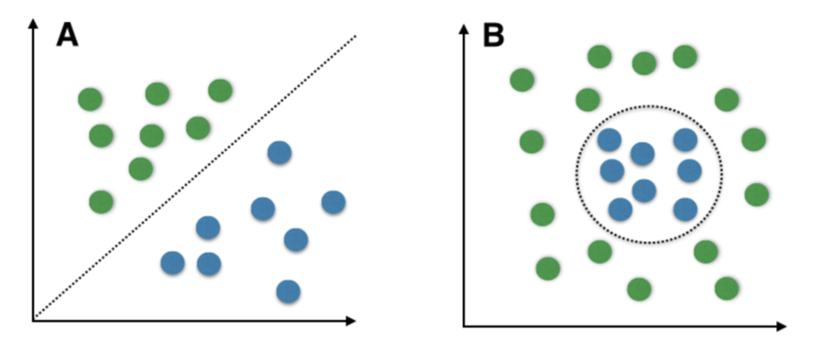
Osama Alyami
Linearly Separable Data: is any data that can be plotted in a graph and can be separated into classes using a straight line.
When the data is not linearly separatable, then SVM needs to convert it to a higher dimensions through a function called Kernel.

Slide 12
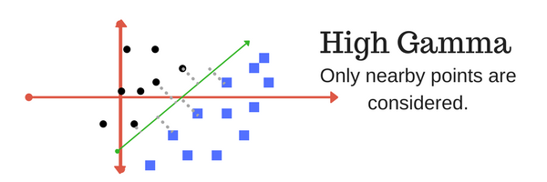
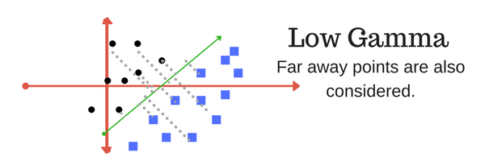
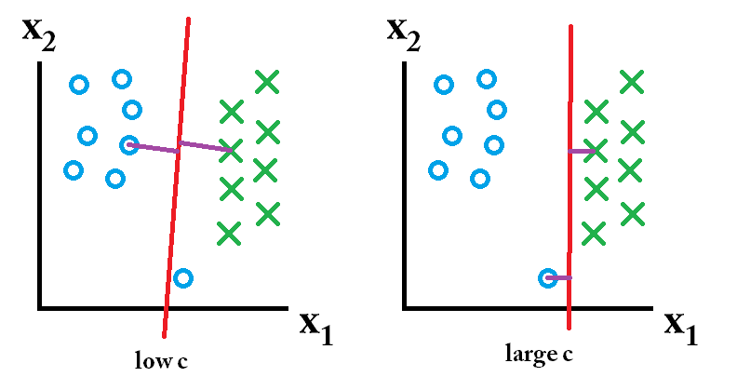
Osama Alyami
Important Parameters in SVM:
Kernel is a function that maps the data to a higher dimension where the data is separable.
Gamma: This parameter decides how far the influence of a single training example reaches.
C parameter: This parameter controls the amount of regularization applied to the data.
Neglect it as error

Slide 13

Osama Alyami
Pros of SVM:
They perform very well on a range of datasets.
They are versatile: different kernel functions can be specified, or custom kernels can also be defined for specific datatypes.
They work well for both high and low-dimensional data.

Slide 14
Osama Alyami
Cons of SVM:
Efficiency (running time and memory usage) decreases as the size of the training set increases.
Needs careful normalization of input data and parameter tuning.
Does not provide a direct probability estimator.
Difficult to interpret why a prediction was made.

Slide 15


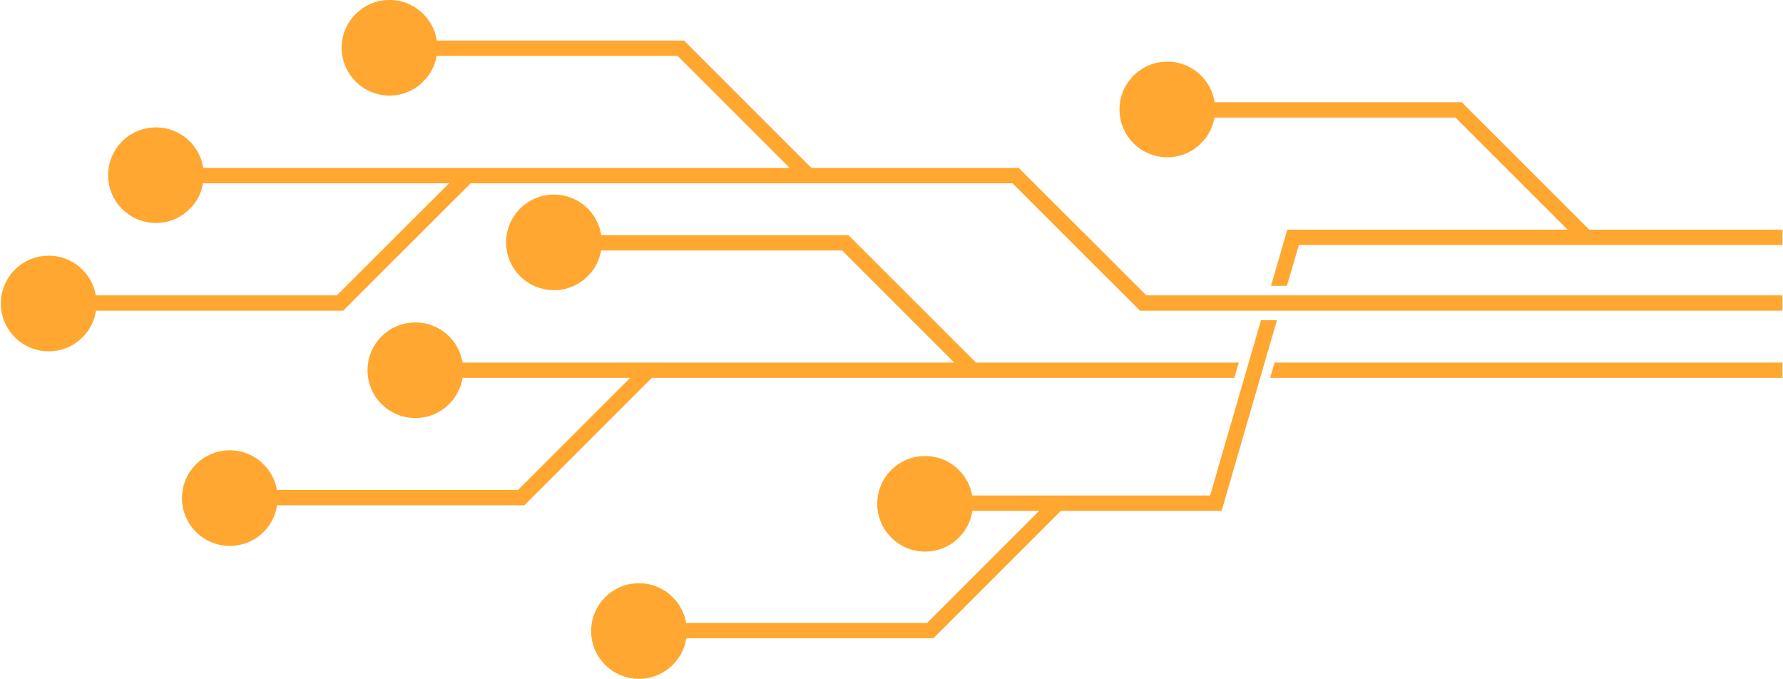
Osama Alyami
Any questions ?
let’s take a Break
for 5 minutes

Slide 16
Shahad Ajibi
Model Evaluation
A machine learning (ML) model is validated by evaluating its prediction performance. Ideally, this evaluation should be representative of how the model would perform when deployed in a real-life setting or with unseen data.

Slide 17
Shahad Ajibi
Model evaluation metrics help to
01
02
03
Compare different models
Estimate the generalization accuracy of a model on future data
Assess the goodness of fit between the model and data

Slide 18
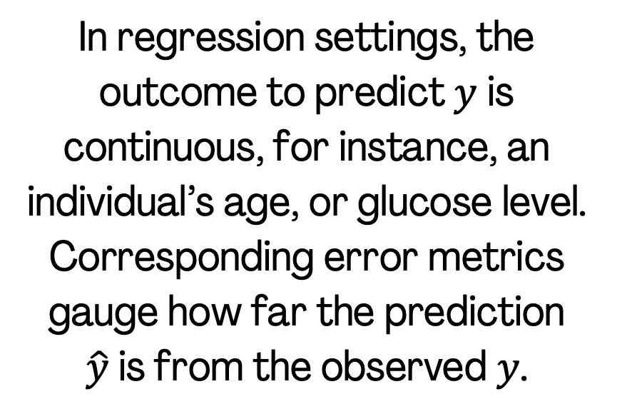
Shahad Ajibi
Performance metrics of
Supervised ML
Classification
Regression
The results can be summarized in a matrix called the confusion matrix. For binary classification, the matrix divides the test samples into four categories, depending on their true and predicted labels.
In regression settings, the outcome to predict $y$ is continuous, for instance, an individual’s age, or glucose level. Corresponding error metrics gauge how far the prediction $\hat{y}$is from the observed $y$.

Slide 19
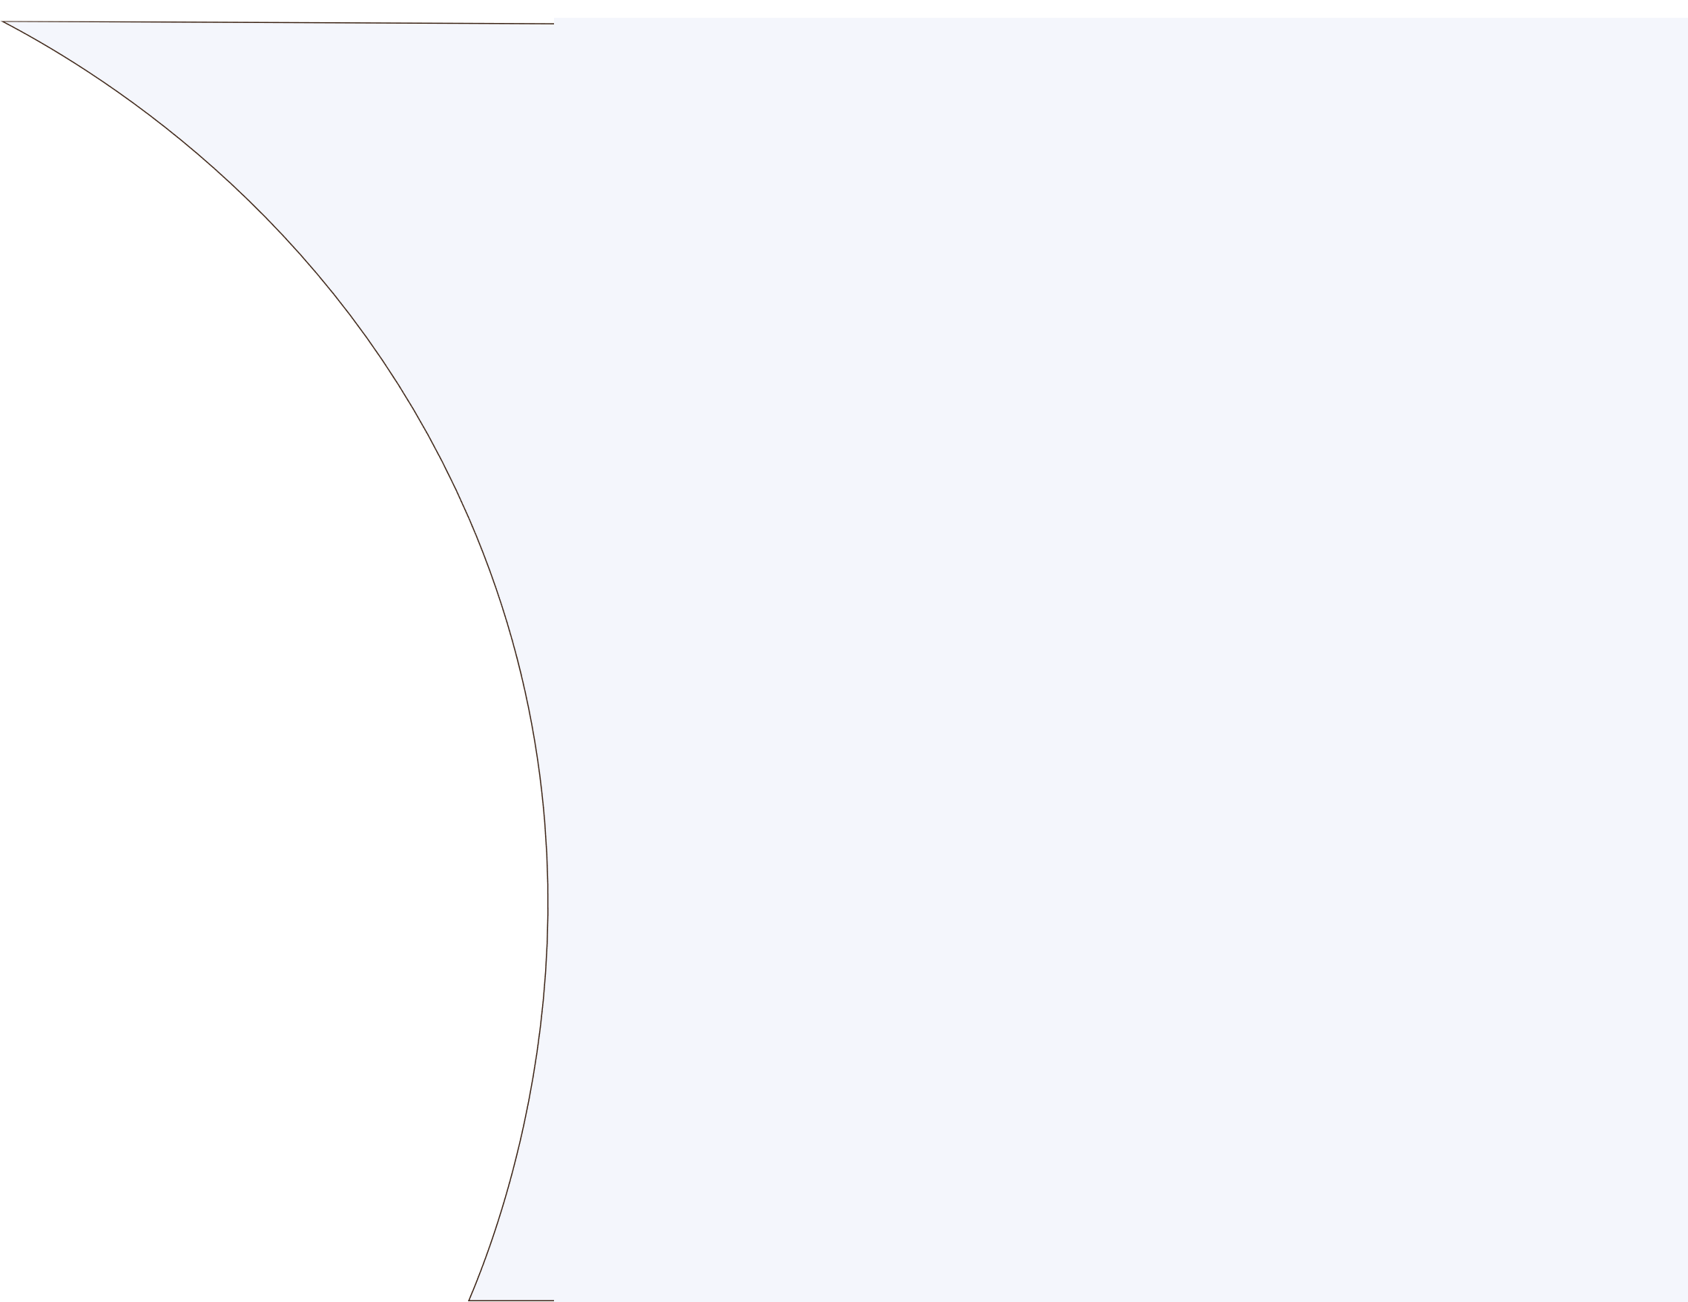


Shahad Ajibi
Classification Matrices
Confusion Matrix
Accuracy
Pression
Recall
F1-Score

Slide 20
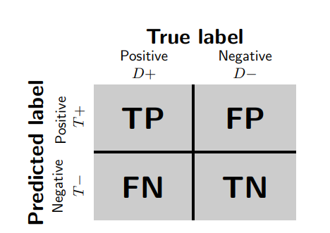
Shahad Ajibi
Confusion Matrix
The confusion matrix (or confusion table) shows a more detailed breakdown of correct and incorrect
classifications for each class
True Positives (TP): samples for which the true and predicted labels are both 1.
True Negatives (TN): samples for which the true and predicted labels are both 0.
False Positives (FP): samples for which the true label is 0 and the predicted label is 1.
False Negatives (FN): samples for which the true label is 1 and the predicted label is 0.

Slide 21
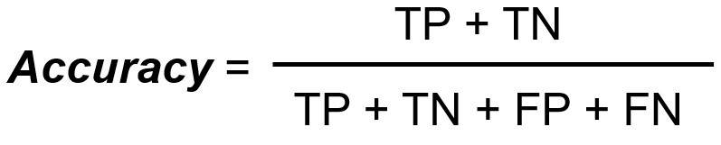
Shahad Ajibi
Accuracy
Accuracy is a common evaluation metric for classification problems. It’s the number of correct predictions made as a ratio to all predictions made.

Slide 22
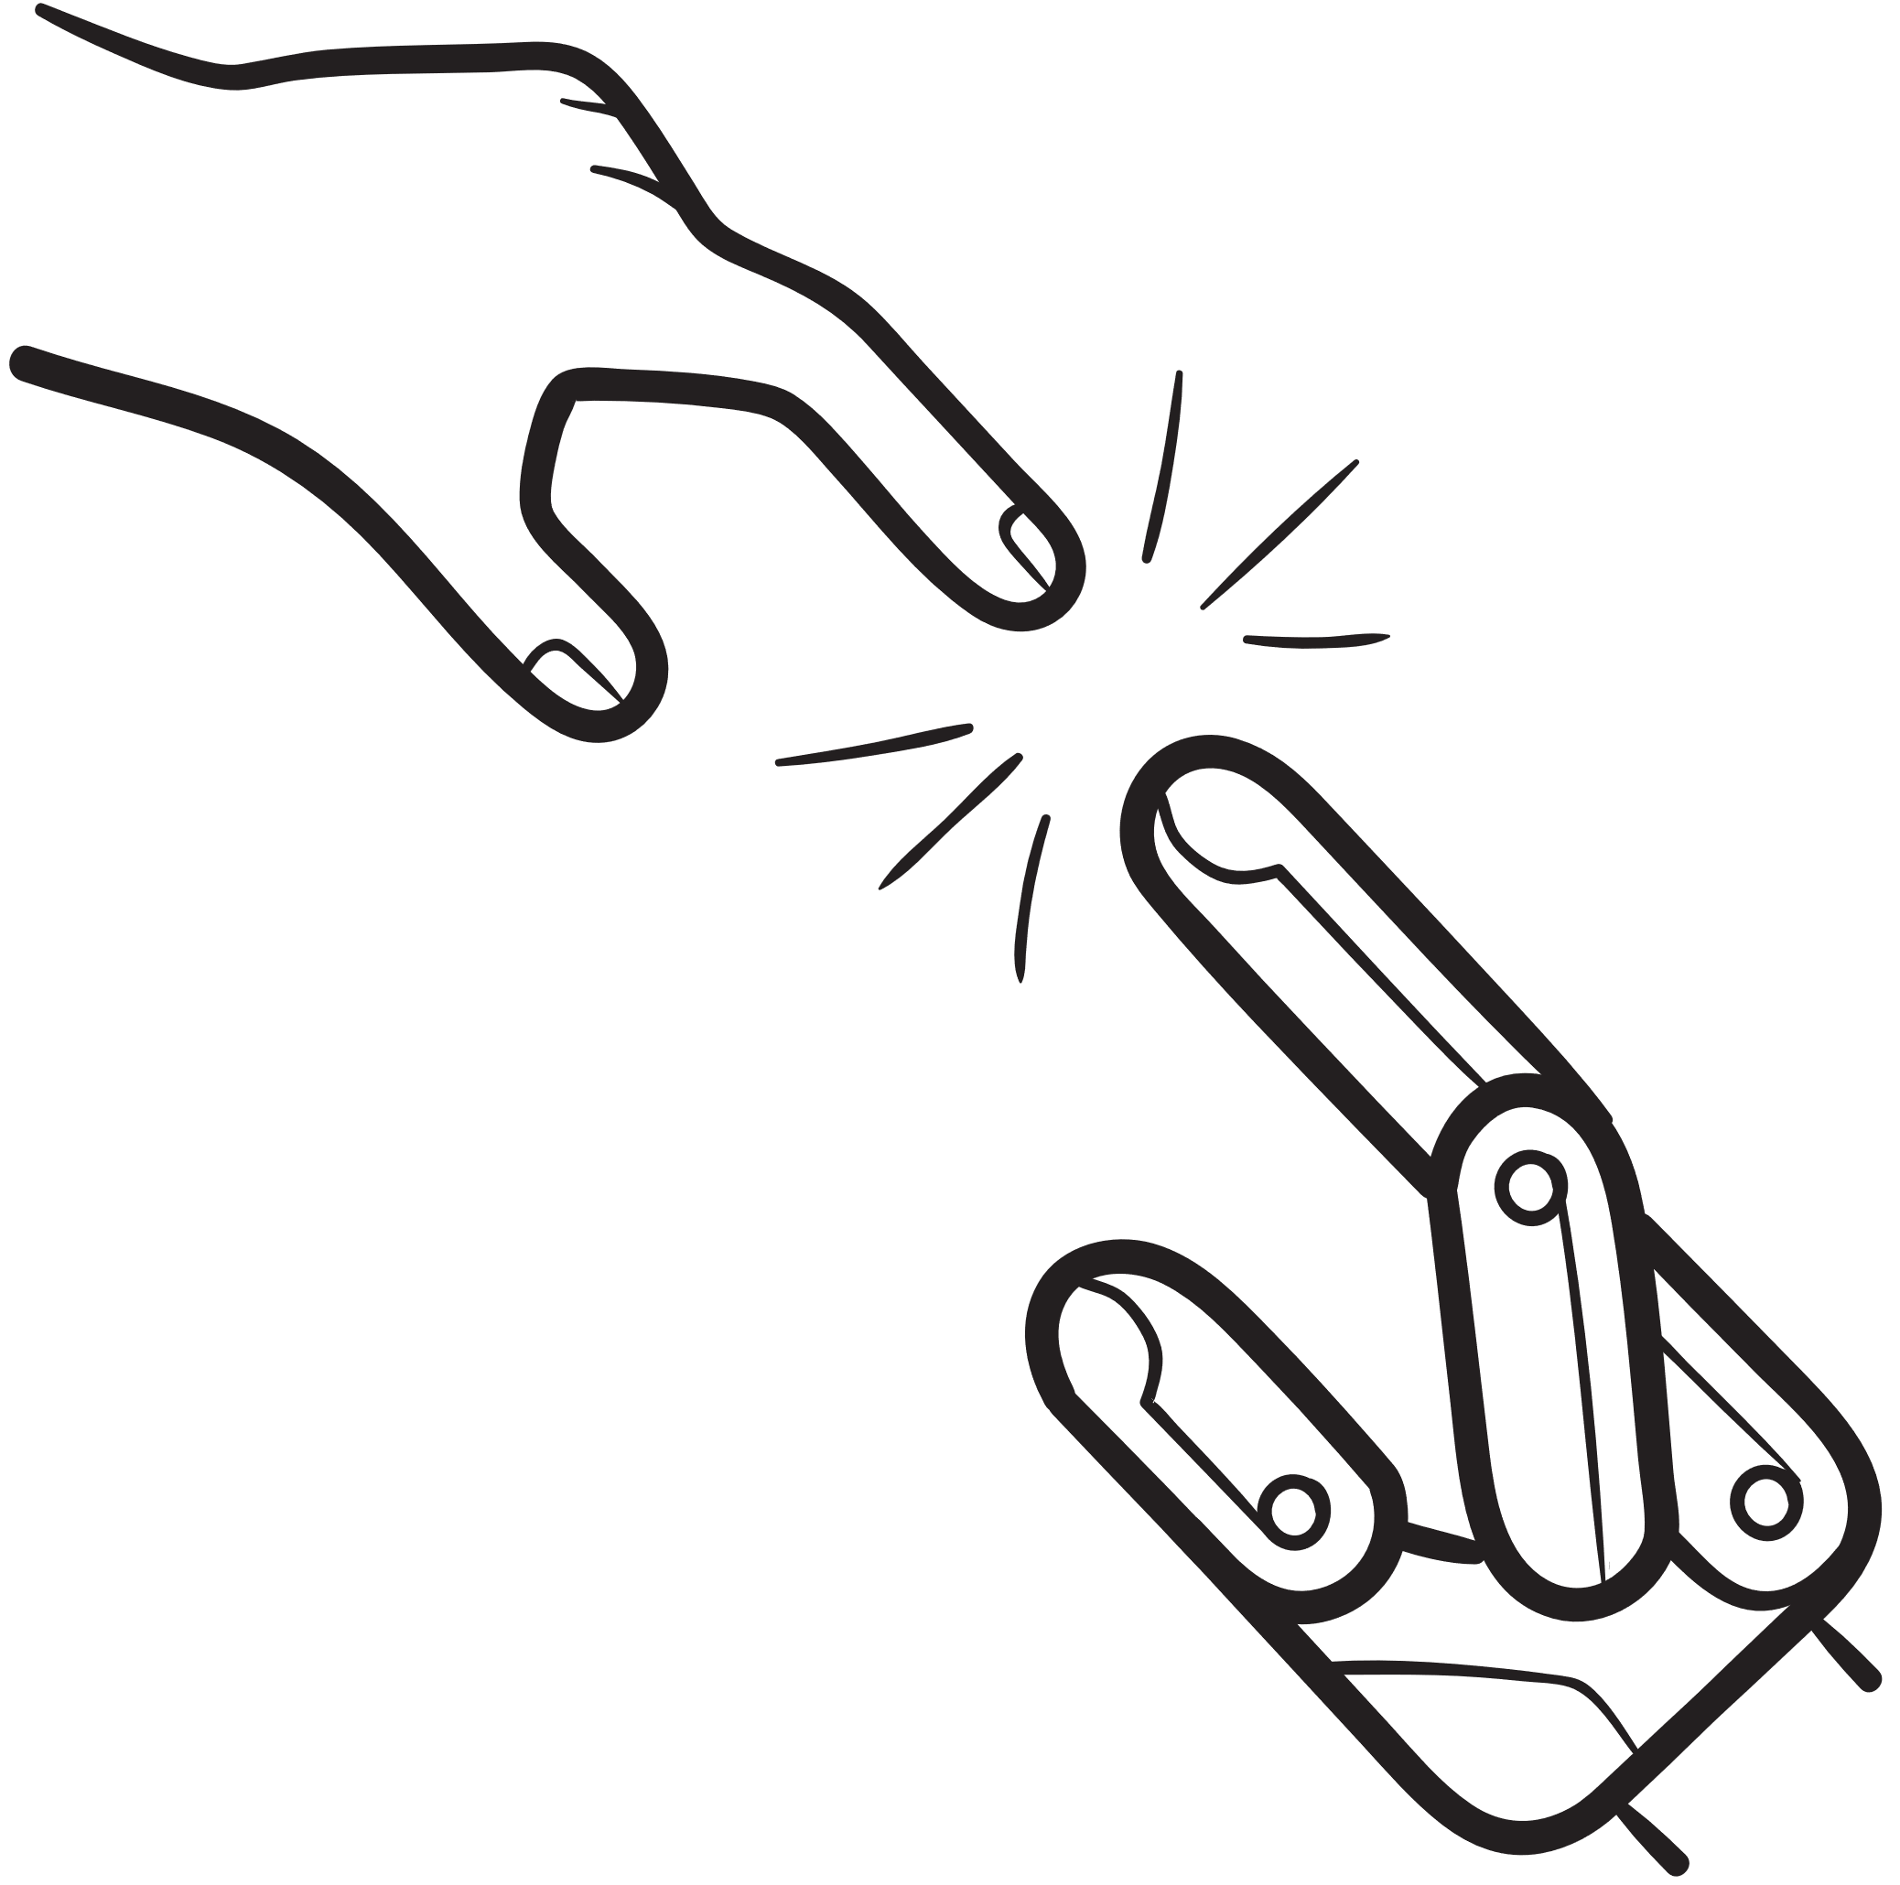
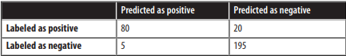
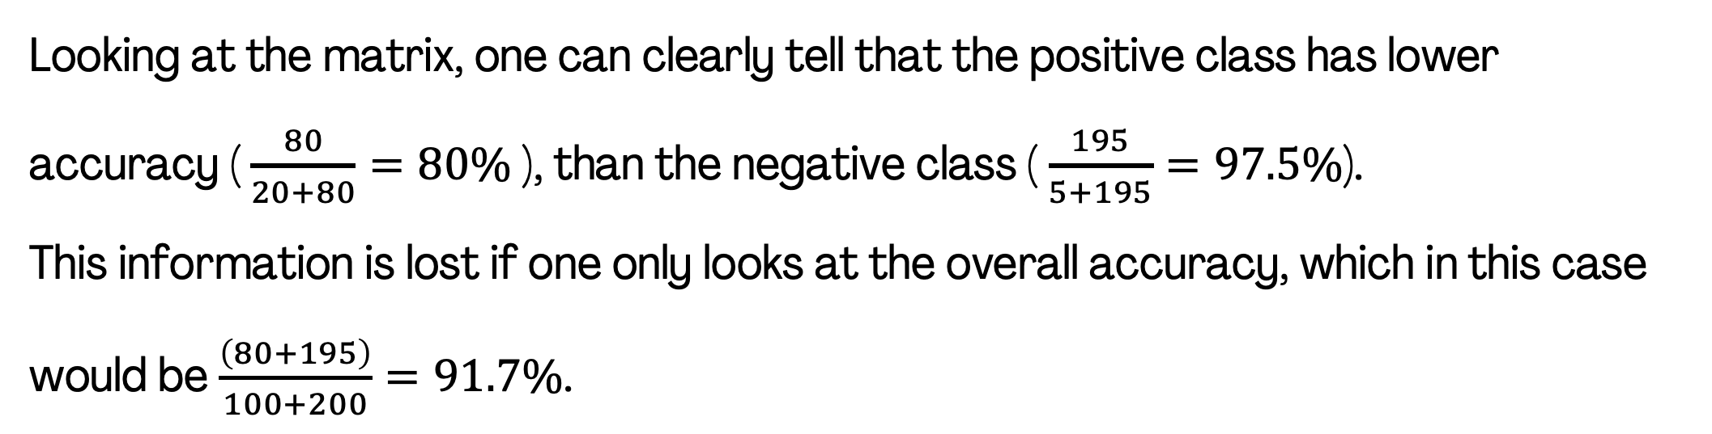
Shahad Ajibi
Is it enough to consider only accuracy?
Suppose the test dataset contains 100 examples in the positive class and 200 examples in the negative class; then, the confusion table might look something like this:
Looking at the matrix, one can clearly tell that the positive class has lower accuracy ( $\frac{80}{20+80}=80\%$ ), than the negative class ( $\frac{195}{5+195}=97.5\%$).
This information is lost if one only looks at the overall accuracy, which in this case would be $\frac{\left(80+195\right)}{100+200}=91.7\%$.

Slide 23
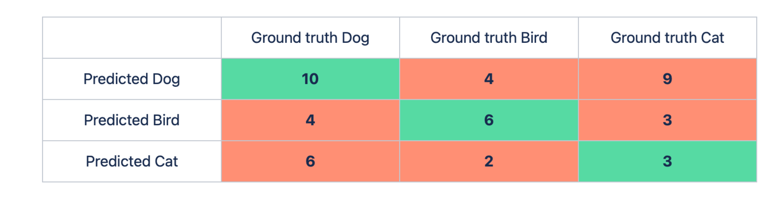
Shahad Ajibi
Exercise 1
The below table shows a confusion matrix of a multiclass classification problem. Calculate the accuracy:

Slide 24
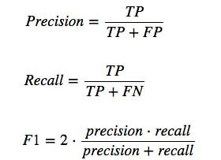
Shahad Ajibi
Pression, Recall and F1-Score
Precision: is the percentage value indicating how many of those results are correct.
Recall: is the percentage value indicating how many of the correct results are found.
F1-score: is the harmonic mean of Precision and Recall values of a system.

Slide 25
Shahad Ajibi
Regression Matrices
R-Squared Score
Mean Absolute Error (MAE)
Root Mean Squared Error (RMSE)

Slide 26
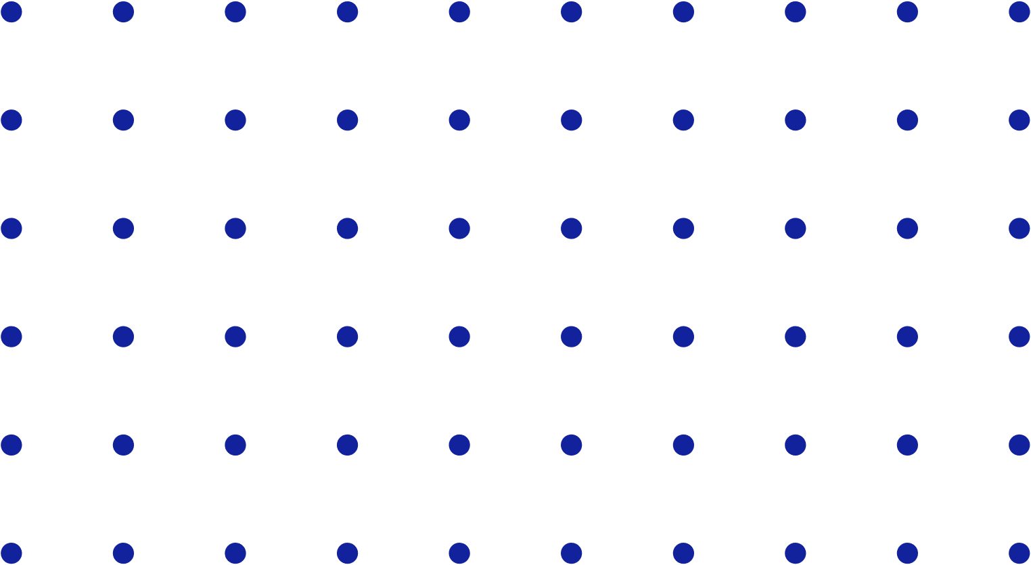
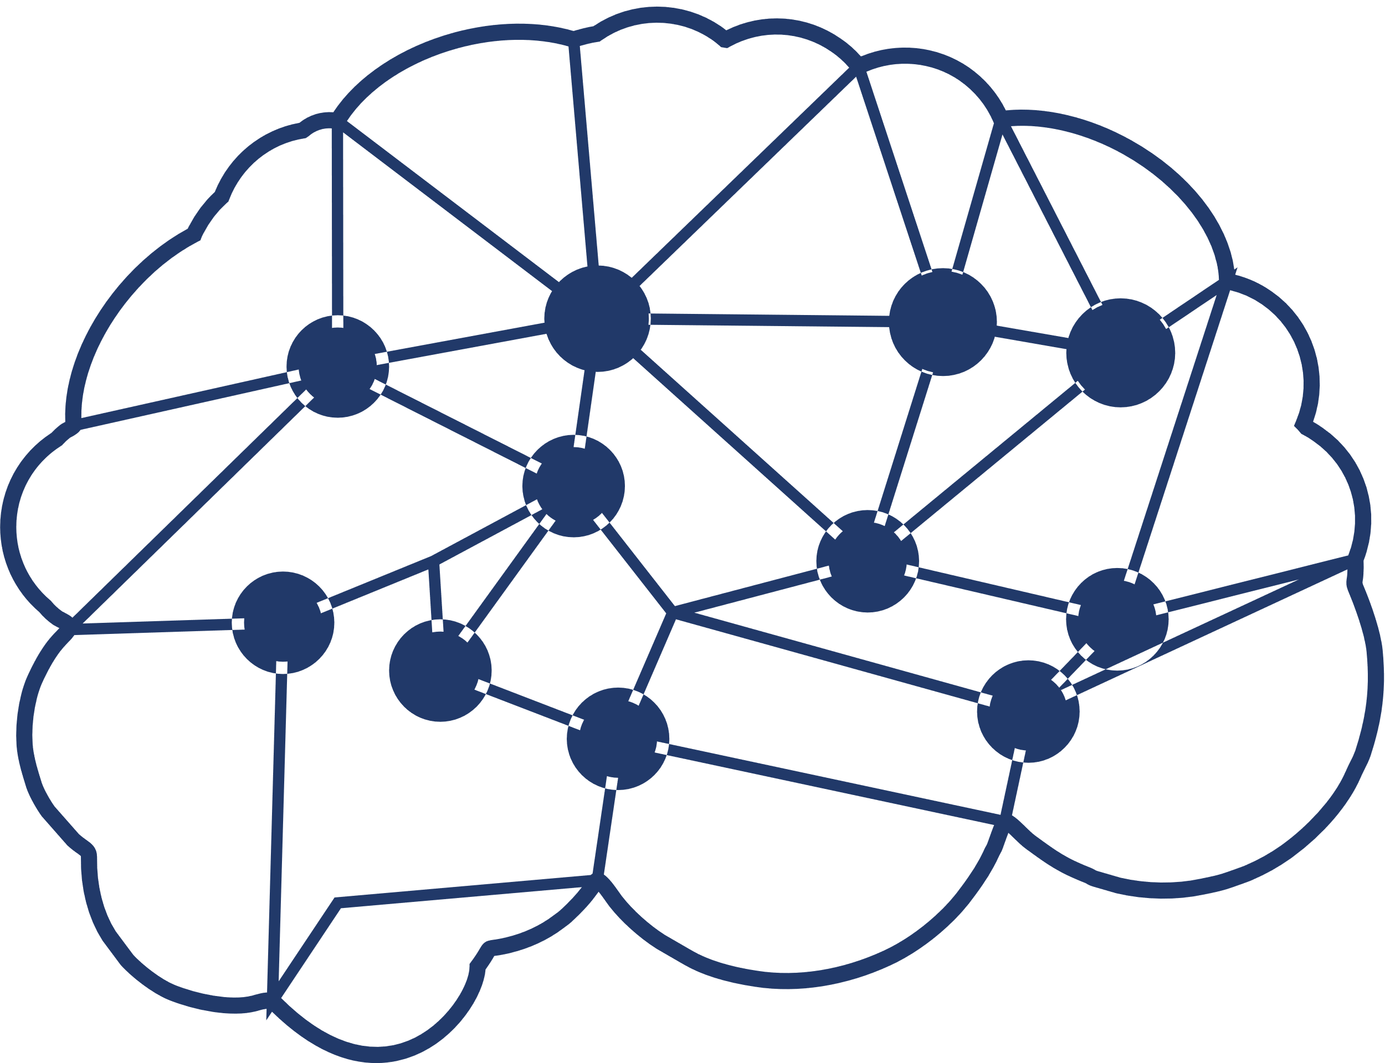
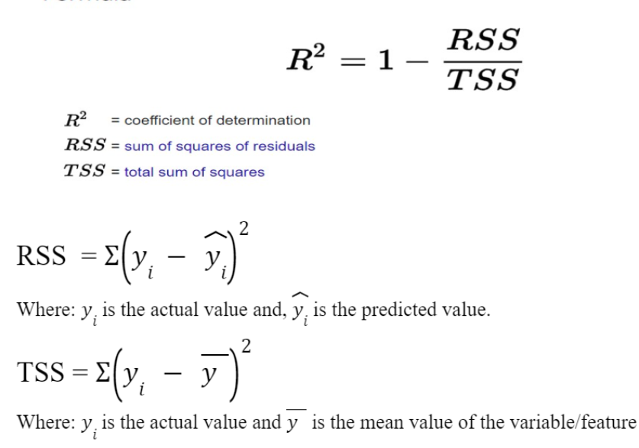
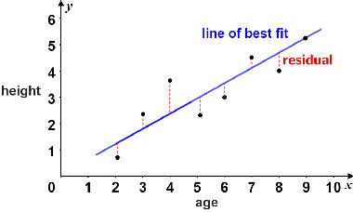
Shahad Ajibi
R-Squared Score
The R-Squared Score is a statistical measure that tells us how well our model is making all its predictions on a scale of zero to one.

Slide 27
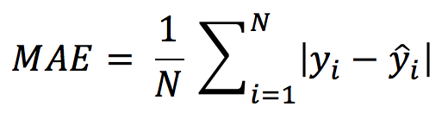
Shahad Ajibi
Mean Absolute Error (MAE)
The MAE is simply defined as the sum of all the distances/residuals (the difference between the actual and predicted value) divided by the total number of points in the dataset.
The absolute symbol makes sure that the negative residual (which may be a result where the predicted value is greater than the actual value) is converted to positive.
When to Use MAE?
To know how close the predictions are to the actual model on average.
Just keep in mind that low MAE values indicate that the model is correctly predicting. Larger MAE values indicate that the model is poor at prediction.

Slide 28
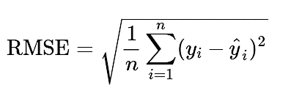
Shahad Ajibi
Root Mean Squared Error (RMSE)
The square root of the average squared distance (difference between actual and predicted value). RMSE is defined as the square root of all the squares of the distance divided by the total number of points.
RMSE functions similarly to MAE but with a minor difference.
RMSE determines whether there are any large errors or distances that could be caused if the model overestimated the prediction (that is the model predicted values that were significantly higher than the actual value) or underestimated the predictions (that is, predicted values less than actual prediction).
When to Use RMSE?
If you are concerned about large errors. If the model overestimated or underestimated some points in the prediction (because the residual will be square, resulting in a large error), you should use RMSE.
RMSE not only calculates how close the prediction is to the actual value on average, but it also indicates the effect of large errors.

Slide 29
Any questions ?
let’s take a Break
for 5 minutes

Slide 30
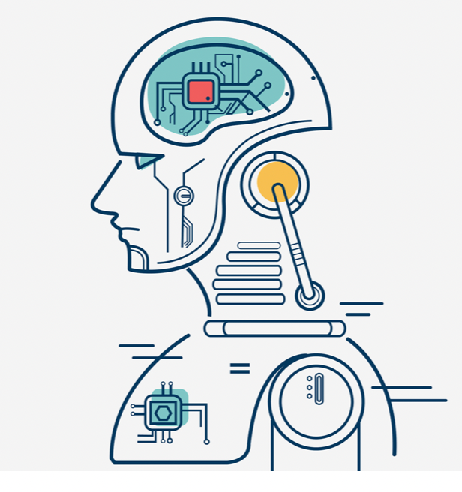
Osama Alyami
The main of objective of machine learning
The main objective of machine learning models is to achieve good performance when new –and not previously seen– entries are analyzed. This is known as Generalization.
It’s essential for the model to function correctly across a whole range of new inputs, not just the examples that it was trained with.
Training Set: is used to train the parameters of the model.
Validation Set: is used to estimate the generalization error during and after training.
In general, between 70% to 80% of the data is used for training, while the rest is used for validation.

Slide 31
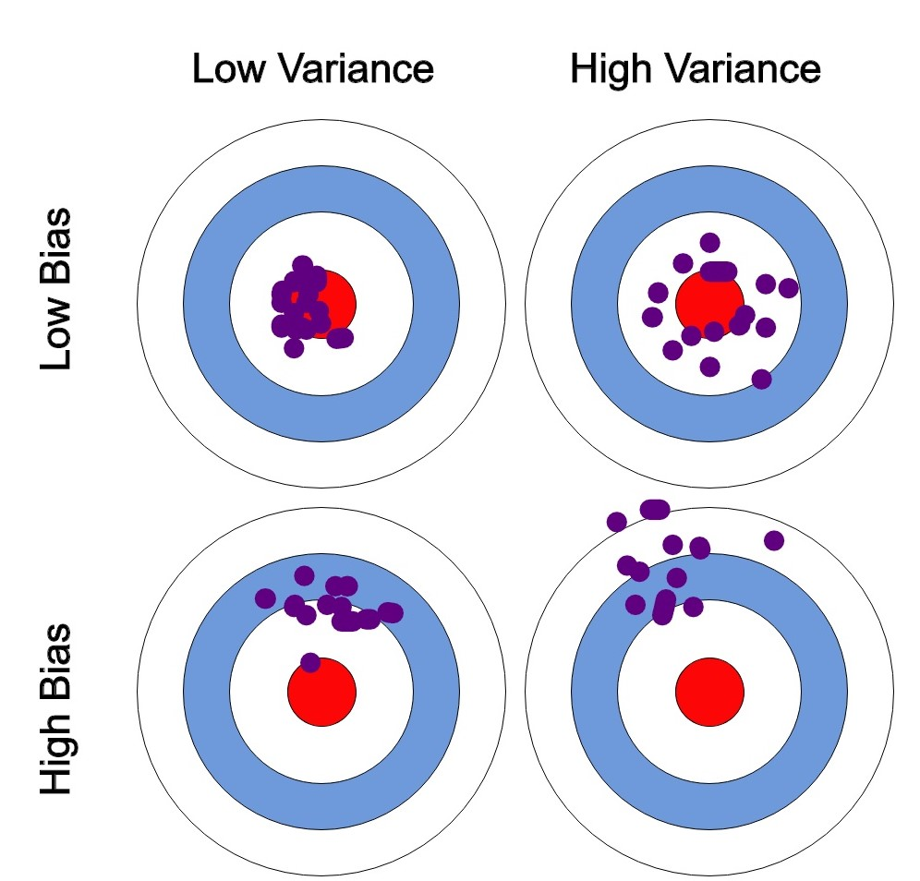
Osama Alyami
Bias and variance
Bias: the error rate of a learning algorithm on the training set, in other words, is the simplifying assumptions made by the model to make the target function easier to approximate.
Variance: how much worse the performance of an algorithm on the validation set is with respect to the training set.
So, how well a machine learning algorithm works is determined by its ability to:
Reduce training errors.
Reduce the gap between training and validation errors.

Slide 32
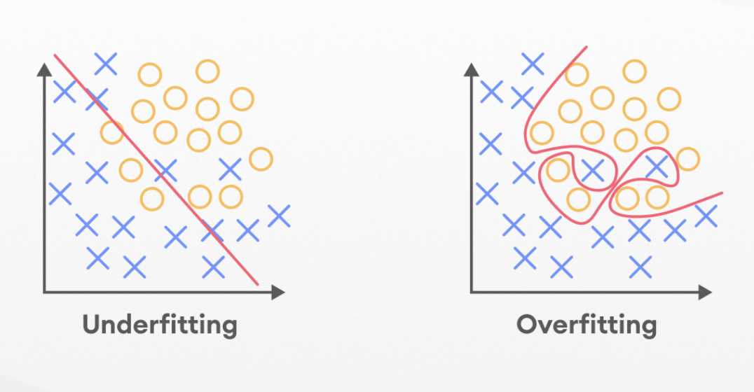
Osama Alyami
Underfitting & Overfitting
Underfitting: occurs when the model is not able to obtain a sufficiently low error on the training set, meaning it’s not able to find or model relevant data patterns from data input.
Overfitting: occurs when the performance of the model on the training set is good, but it lowers considerably on the validation set, meaning the gap between the training error and the validation error is too big.
UnderFitting | OverFitting
More complex model | More simple model
Less regularization | More regularization
Larger quantity of features | Smaller quantity of features

Slide 33
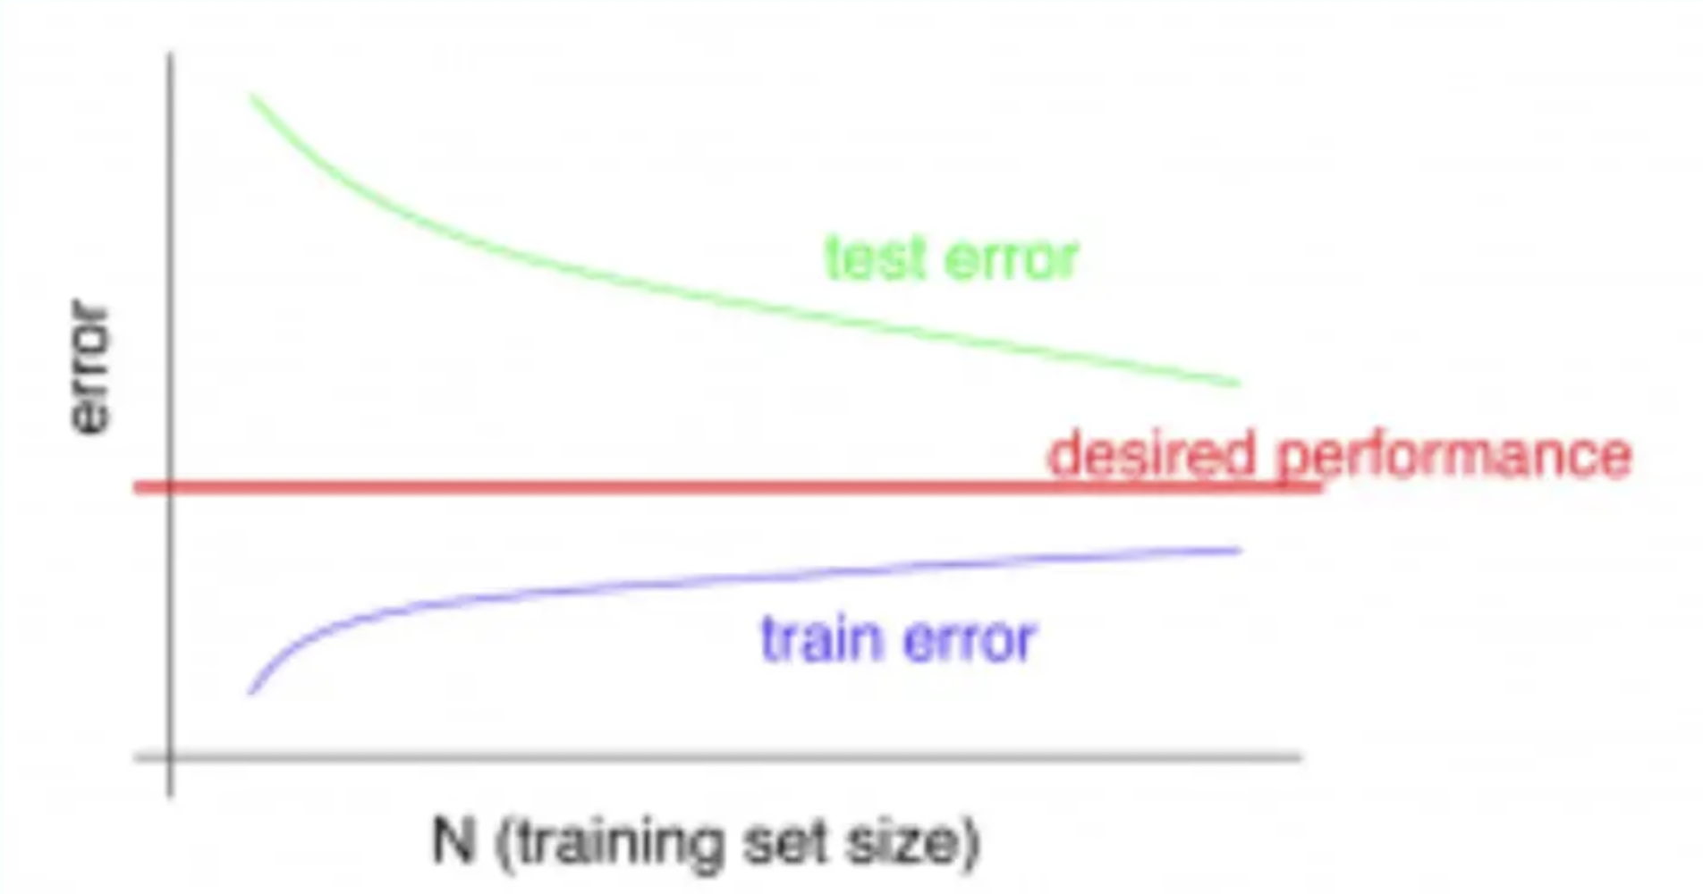
Osama Alyami
How do we fix the high bias in the dataset?
High bias happens because the model is too simple for the data, and we also see a high training error.
To fix that we can do the following:
Add more input features.
Add more complexity with polynomial features.
Decrease Regularization term.
High bias -Test error is not reduced with more training data

Slide 34
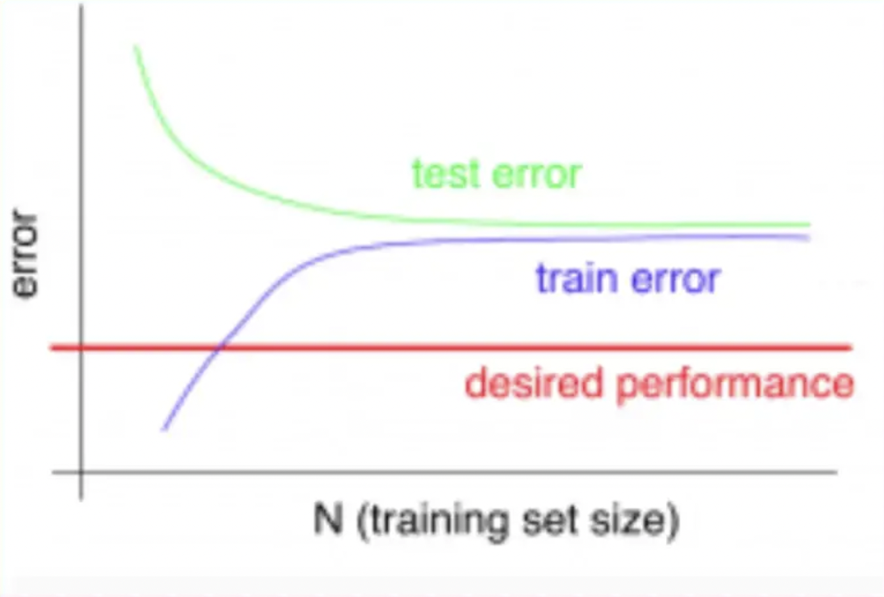
Osama Alyami
How do we fix the high variance in the dataset?
High variance is due to a model that tries to fit most of the training dataset points and hence gets more complex.
To resolve high variance issue, we need to work on :
Getting more training data.
Reduce input features.
Increase Regularization term.
High variance — Test error is reduced with more training data

Slide 35
Any questions ?
let’s take a Break
for 5 minutes

Slide 36
Sadeem AlMesned
What is data splitting?
Data splitting is when data is divided into two or more subsets. Typically, with a two-part, one part is used to evaluate or test the data and the other to train the model
In machine learning, data splitting is typically done to avoid overfitting and to retain some remaining data to evaluate the model.​

Slide 37
Sadeem AlMesned
Techniques of splitting the data
Split
Cross Validation
The model is fitted and evaluated one time on the specified train/test split of the data.
The model is fitted and evaluated multiple times on different train/test splits of the data.

Slide 38
Sadeem AlMesned
The original data in a machine learning model is typically taken and split into three sets.
The training set: is the portion of data used to train the model.
The validation set: is a data set of examples used to change learning process parameters.
The testing set: is the portion of data that is tested in the final model and is compared against the previous sets of data.
Test
Train
Validation

Slide 39
The original data in a machine learning model is typically taken and split into three sets.
Sadeem AlMesned
The training set: is the portion of data used to train the model.
The testing set: is the portion of data that is tested in the final model and is compared against the previous sets of data.
K=1
K=2
K=3
K=4
K=5

Slide 40

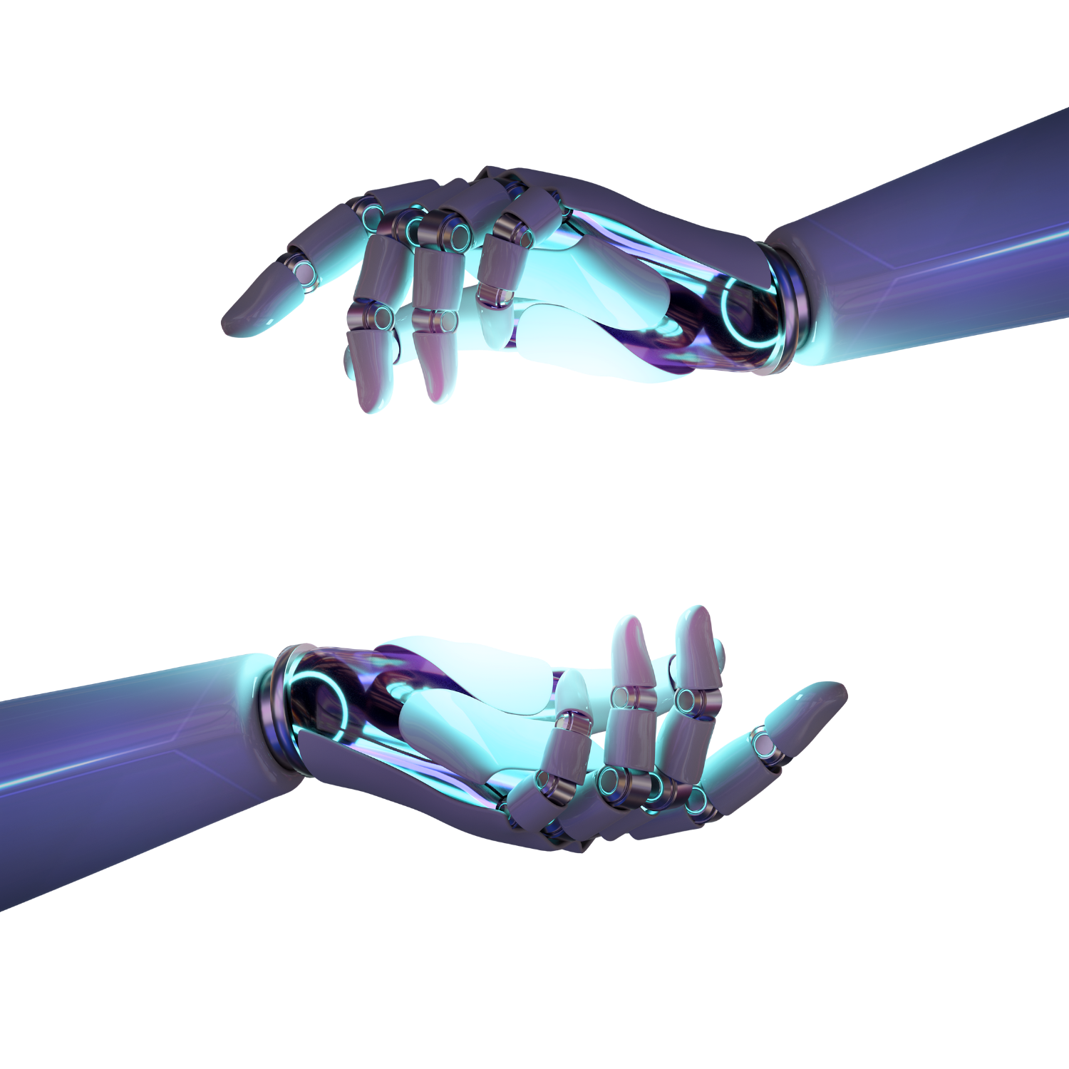

Thank You

